Slide 1
Exploring the Effect of Sentiment on Number of YouTube Comment Likes

Slide 2
Project Aim
To understand the influence of YouTube video comment sentiment on the number of likes each comment received
Dependent variable: number of YouTube comment likes
Independent variable: sentiment

Slide 3
Methods
Scraped 100 comments and number of comment likes from 30 YouTube videos using YouTube’s API
Used IBM Watson’s Natural Language Understanding tool to process comments for sentiment

Slide 4
Analysis
Challenges
Solution
Dependencies were present in the data due to comments being “nested” within videos
Nested data are not properly accommodated by standard regression techniques
Many comments had zero likes
Zero-inflated outcome variables are not properly accommodated by Poisson or negative binomial models
Two-part multilevel model
Multilevel models can be used to account for these dependencies
Two-part models can be used to properly accommodate excessive zeros

Slide 5
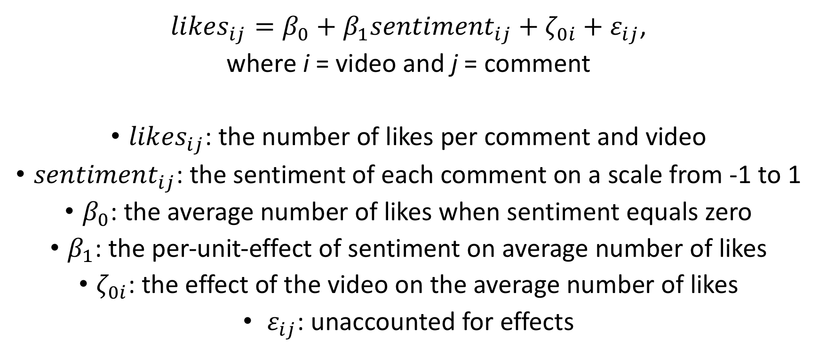
The Multilevel Model
${likes}_{ij}=β_{0}+β_{1}{sentiment}_{ij}+ζ_{0i}+ε_{ij}$,
where i = video and j = comment
${likes}_{ij}$: the number of likes per comment and video
${sentiment}_{ij}$: the sentiment of each comment on a scale from -1 to 1
$β_{0}$: the average number of likes when sentiment equals zero
$β_{1}$: the per-unit-effect of sentiment on average number of likes
$ζ_{0i}$: the effect of the video on the average number of likes
$ε_{ij}$: unaccounted for effects

Slide 6

The Two-part Multilevel Model
For ${likes}_{ij}=0$:
Fit a binary multilevel model
For ${likes}_{ij}>0$:
Fit a Poisson multilevel model

Slide 7
Results
Sentiment did not have a significant effect on whether or not a comment received likes (binary model)
Sentiment had a significant effect on the number of likes a comment received (Poisson model)

Slide 8
Software
Python was used to access YouTube’s API and BIM Watson’s Natural Language Understanding tool
SAS was used to model the data

